Slide 1




HackOrbit 2025
SoloCode

Slide 2

THEME & PROBLEM STATEMENT
Theme: Artificial Intelligence and Machine Learning
Problem Statement:
India’s street food scene is vibrant, delicious—and often unhygienic.
Lack of hygiene awareness and regulation leads to foodborne illnesses, especially in urban and semi-urban areas.
Consumers have no reliable way to assess stall cleanliness in real-time before buying.
This results in health risks, loss of trust, and limited accountability among vendors.

Slide 3
PROPOSED SOLUTION
Solution : HygieScan
A smartphone app that uses AI-powered computer vision and crowdsourced reports to assess the hygiene of street food vendors in real time

Slide 4
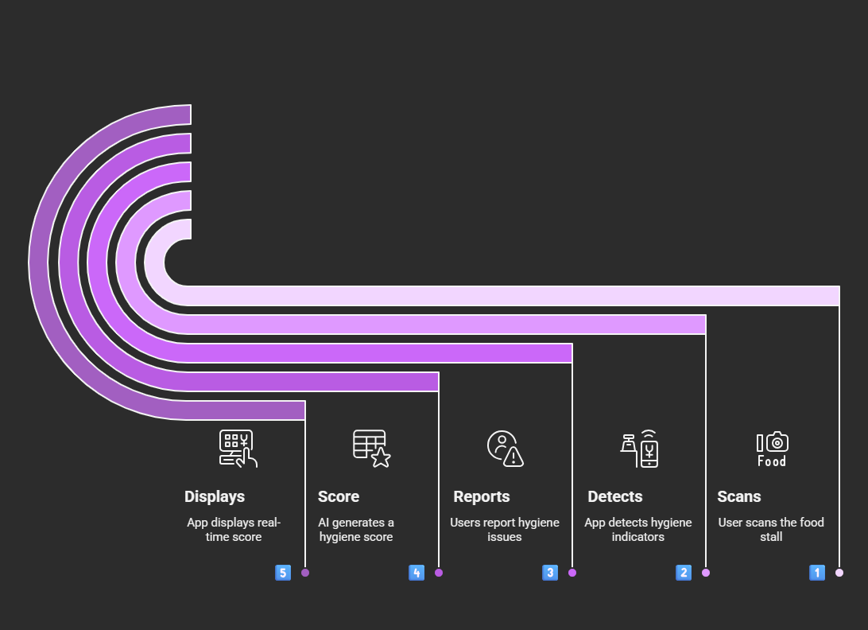
FLOWCHART / DIAGRAM

Slide 5
FLOWCHART / DIAGRAM
1) Scan vendor stall:
Initiates hygiene check via mobile camera.
Makes it user-friendly — anyone with a phone can participate
2) AI-Based Visual Analysis:
Detects gloves, covered food, clean counters, hand hygiene.
Automates hygiene detection — fast & unbiased.
3) User Reports Hygiene Observations:
Users can flag things AI might miss (e.g., smell, flies)
4) Hygiene Scores:
Combines visual cues + reports using weighted logic
Balances AI accuracy with public input — reduces false positives
5) App Shows Hygiene Score + Advice:
Displays final result with message like “Safe to eat” or “Risky vendor”
Helps users make instant decisions; builds trust in the system

Slide 6
FEATURES ND NOVELTY
Features
Novelty
1) Uses MobileNet CNN to detect gloves, utensils, trash, etc., from live camera feed
2) Supports Hindi, Tamil, Marathi, Bengali for local usability
3) Users report real-time conditions (“flies”, “no gloves”) via buttons or voice.
4) Users earn points, badges (e.g., “Hygiene Hero”) for contributing observations
5) A Location-Tagged Vendor Map where you can view nearby stalls and their hygiene scores before eating
1) Works on any smartphone — no IoT or special sensors required
2) Fast, on-the-spot feedback that helps users decide before buying food
3) Combines real-time computer vision with public human reports — very few apps do both
4) Potential to share anonymized hygiene trends with civic bodies for public health monitoring

Slide 7
DRAWBACK AND SHOWSTOPPERS
Current Limitations of HygieScan:
1) No existing hygiene-focused vendor image dataset — needs manual collection
2) Vendor privacy concerns
3) Variability in lighting, camera angles, and occlusion can reduce model precision
Potential Showstoppers :
1) False Positives/Negatives
Issue: AI might misclassify hygiene conditions
Fix: Train on diverse dataset + combine with user feedback for higher accuracy
2) Low User Participation:
Issue: Crowdsourcing fails if users don’t report regularly
Fix: Add gamification (points, badges, leaderboard) to boost engagement
3) No Official Health Body Backing:
Issue: App may lack public credibility or recognition
Fix: Plan to collaborate with FSSAI or local health authorities for validation

Slide 8
CodeSolo
Shweta Umbrajkar Phone NO: 9960962814
Email: Shweta.22311909@viit.ac.in

Slide 9
Thank you

